Slide 1


Research Paper:
Teaching English Online
Through Skype (VOIP)
Student’s Name: -Valentina Acuña Z.
-Luis Gutierrez O.
- Alexa Reichelt B.
Concepción, November 19th, 2015

Slide 2
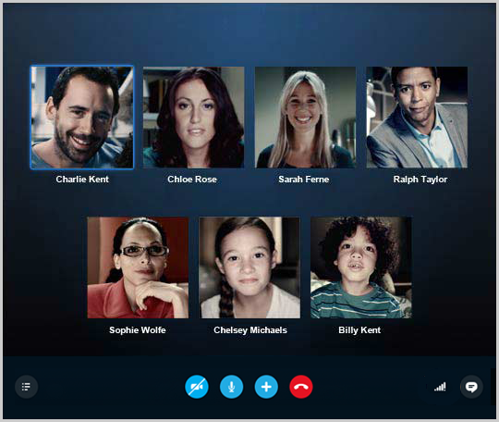
Research question or Hypothesis.
This study is based on two questions:
1. How and to what extent do the Institute's topic-based conversation assignment questions provide an adequate foundation and sufficient stimuli to assist the development of dialogues and patterns of interaction which facilitate language learning?
2. Which pedagogical and technical skills do Conversation Facilitators need to develop in order to allow them to facilitate dialogues and patterns of interaction which promote language learning?

Slide 3



Purpose of the study
This study focuses on teaching English conversation to undergraduate students in Iran.
Native speakers of English function as Conversation Facilitators (CFs) using audio conferencing like Skype to talk with small groups of students or converse one-to-one.
The goal of the conversations is to increase students' oral proficiency defined in terms of fluency, accuracy and complexity.

Slide 4

Brief empirical research
The Norwegian University of Science of Technology (NTNU) in Trondheim uses Skype to teach oral Spanish and French to lower-intermediate and beginner students.
Østfold College uses Elluminate for the teaching of oral French to low to upper-intermediate students.

Slide 5

Type of study
Semi-structured interviews
The interviews were done with CFs (Conversation Facilitators) to find ways to improve the speaking skills.
The study uses a qualitative method
Conversation facilitators
The CFs are native English Speakers or have lived in English Speaking countries for many years with an average aged in the late 40s.

Slide 6




Samples
The participants of this study are undergraduate students in Iran, who are not permitted to attend ordinary universities.

Slide 7

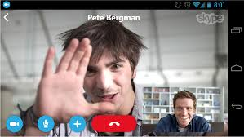

Instruments
Use of audio conference platforms like Skype as semi-structure interviews to talk with small groups of students or converse one-to-one.
The interviews aimed to find out more about how the conversations were being conducted, as well as to investigate which one of the tasks was providing an adequate basis and stimuli for the dialogues.

Slide 8
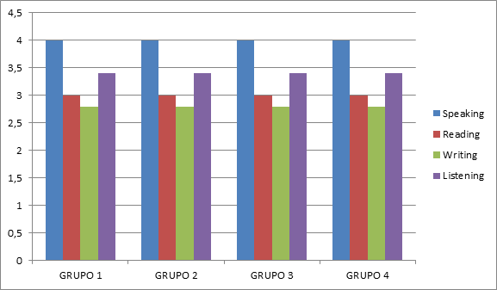
Results and main conclusions
LEVELS.
4= KET
3= PET
2= BEGINNER
1= SURVIVAL

